Slide 1
THE CIVIL WAR
Notes:
The CIVIL WAR was a tragedy of four long and bloody years, Americans were killed at the hands of other Americans. One of every 25 American men perished in the war. Over 640,000 soldiers were killed. Many civilians also died — in numbers often unrecorded.
The war was fought in American fields, on American roads, and in American cities with a ferocity that could be evoked only in terrible nightmares. Nearly every family in the nation was touched by this war. Scarcely a family in the South did not lose a son, brother, or father.
Four long years of battle changed everything. No other event since the Revolutionary War altered the political, social, economic, and cultural fabric of the United States. In the end, a predominantly industrial society triumphed over an agricultural one. The Old South was forever changed. The blemish of slavery was finally removed from American life, though its legacy would long linger.
In 1861, everyone predicted a short war. Most believed that one battle of enormous proportion would settle a dispute at least 90 years in the making. But history dictated a far more destructive course.

Slide 2
The War in the West
Section 3
P522-527

Slide 3
Union Strategy in the West
In February 1862 General Ulysses S. Grant Led a Union army into Tennessee.

Slide 4
Western campaign focused on taking control of Mississippi River.
Would cut off eastern part of Confederacy from food sources in West.
Union could use bases along the Mississippi to attack communication and transportation networks.
Grant’s Army of Tennessee captured Confederate forts on Tennessee and Cumberland rivers in February 1862.

Slide 5
Battle of Shiloh
Near Shiloh Church, Grant stopped his troops to wait for more soldiers to arrive.
Grant was aware of Confederate troops in the area, but was caught by surprise when they attacked on April 6.
Notes:
The Confederate attack hit two inexperienced divisions near Shiloh Church (the battle is known as both Shiloh and Pittsburgh Landing). Johnston committed his entire army as quickly as possible (a rare feat during the civil war), hitting two inexperience Union divisions that happened to be camped a little further west than the rest of the army. Unfortunately for Johnston, one of those divisions was commanded by William Tecumseh Sherman, who made his reputation at Shiloh.
While Sherman and his men were fighting, Grant was rushing up-river towards the sound of the guns. By the time he arrived, at 9.00 am, the fighting was already the fiercest yet seen in the war. Between then Grant and Sherman were able to hold off everything that Johnston and Beauregard could throw at them, although they were slowly pushed back towards the river. For a large number of Union soldiers, Shiloh was their first taste of combat, and for many it was too much. Amongst Grant’s most important contributions on the first day of Shiloh was that he was able to steady many of these fleeing soldiers, and form new units that could be sent to plug potential gaps in the line or used to form a new defensive line along the line of a waterlogged creek.
Shiloh presents yet another of the Confederacy’s ‘if only’ moment. While attempting to encourage one of his units to charge, Johnston was shot through the leg. He refused to stop for treatment, until eventually almost falling off his horse as he died of blood loss. Johnston was considered to have been the best soldier of his generation (although had yet to prove it), and his lose is often blamed for the defeat at Shiloh. In reality, the Confederate army was almost exhausted by this point, while the Union army had a strong line to fall back on, as well as tens of thousands of reinforcements who started to arrive as evening fell.
Having been on the defensive on 6 April, Grant went on to the offensive on 7 April. The battered Confederates managed to hold on for a couple of hours of fighting that matched that of the previous day, but eventually Union numbers and freshness won out. Beauregard was forced from the field, and began a dispirited march back to their base at Corinth.
The true nature of Grant’s victory at Shiloh took some time to sink in. After the first day, the Confederates were already claiming a victory, and it was the first days fighting that most influenced early opinion in the North as well. When the scale of Grant’s victory eventually sank in, his reputation rose to unprecedented levels, although not with Halleck.

Slide 6
During the 2-day battle, each side gained and lost ground.
Union reinforcements arrived.
They made the Confederates retreat.
The Union now controlled part of the Mississippi River Valley.

Slide 7
Fall of New Orleans
U.S. Navy moved upriver to meet Grant, who was moving down the Mississippi.
First obstacle was the port of New Orleans—largest Confederate city and gateway to the Mississippi.
Fleet under Admiral David Farragut captured New Orleans in April 1862.
He then took Baton Rouge, Louisiana, and Natchez, Mississippi.
Notes:
On April 28 the fleets of Farragut and Porter were within the Mississippi River, the former in chief command of the naval forces; and General Butler, with about 9,000 troops. was at the Southwest Pass. The fleets comprised forty-seven armed vessels, and these, with the transports, went up the river, Porter's mortar-boats leading. When they approached the forts their hulls were besmeared with mud, and the rigging was covered with branches of trees. So disguised, they were enabled to take a position near the forts unsuspected. The Mississippi was full to the brim, and a boom and other obstructions near Fort Jackson had been swept away by the flood. On April 18 a battle between Fort Jackson and Porter's mortar-boats was begun. The gunboats supported the mortar-boats. They could not much affect the forts, and on the night of the 23d the fleet started to run by them, the mortar-boats helping. The perilous passage of the forts was begun at 2 A.M. The night was intensely dark, and in the gloom a tremendous battle was waged. The National naval force was met by a Confederate one. In that struggle the Nationals were victorious. While the battle was raging near the forts, General Butler landed his troops, and in small boats passed through narrow and shallow bayous in the rear of Fort St. Philip. The alarmed garrison surrendered to Butler without resistance, declaring they had been pressed into the service and would fight no more. When the forts were surrendered and the Confederate gunboats subdued, Farragut rendezvoused at Quarantine, and then with nine vessels went up to New Orleans. There a fearful panic prevailed, for the people had heard of the disasters below. Drums were beating, soldiers were hurrying to and fro, cotton was carried to the levee to be burned; funds in the amount of $4,000,000 had been carried away from the banks, and citizens, with millions in property, had fled from the city. When Farragut approached (April 23), General Lovell and his troops fled: the torch was applied to the cotton on the levee, and 15,000 bales, a dozen large ships, and as many fine steamers, with unfinished gunboats and other large vessels, were destroyed in the conflagration. The citizens were held in durance by Farragut's guns until the arrival of Butler on May 1, when the latter landed with his troops, took formal possession of the defenseless town, and made his headquarters at the St. Charles Hotel. The loss of New Orleans was a terrible blow to the Confederates.

Slide 8
Siege of Vicksburg
Geography of Vicksburg allowed Confederate General Pemberton to stop any attack on the city.
Grant was called in to help.
Instead of attacking, he decided to cut off the city and bombard it.
Notes:
Vicksburg, SIEGE OF, a noteworthy military operation that began at the close of 1862 and ended early in July following. The Confederates had blockaded the Mississippi River by planting heavy batteries on bluffs at Vicksburg and Port Hudson. These formed connections between the Confederates on each side of that stream, and it was important to break those connections. To this end General Grant concentrated his forces near the Tallahatchee River, in northern Mississippi, where Generals Hovey and Washburne had been operating with troops which they had led from Helena, Ark. Grant had gathered a large quantity of supplies at Holley Springs, which, through carelessness or treachery, had fallen (Dec. 20, 1862) into the hands of Gen. Earl Van Dorn, and he was compelled to fall back to Grand Junction to save his army. Taking advantage of this movement, a large Confederate force under Lieut. Gen, J. C. Pemberton had been gathered at Vicksburg for the protection of that post. On the day when Grant's supplies were seized Gen. W. T. Sherman left Memphis with transports bearing guns to besiege Vicksburg. At Friar's Point they were joined by troops from Hatteras, and were met by Commodore Porter, whose fleet of gunboats was at the mouth of the Yazoo River, just above Vicksburg. The two commanders arranged a plan for attacking the city in the rear, and proceeded to attempt to execute it. The troops and boats went up the Yazoo to capture some batteries that blockaded the way, but were unsuccessful, and abandoned the project. Early in January Gen. J. A. McClernand arrived and, ranking Sherman, took the chief command, and went up the Arkansas River to attack Confederate posts. Meanwhile General Grant had arranged his army into four corps, and with it descended the river from Memphis to prosecute the siege of Vicksburg with vigor. He was soon convinced that it could not be taken by direct assault. He tried to perfect the canal begun by Williams, but failed. Then he sent a land and naval force up the Yazoo to gain the rear of Vicksburg, but was repulsed. Finally Grant sent a strong land force down the west side of the Mississippi, and Porter ran by the batteries at Vicksburg in the night (April 16, 1863) with nearly his whole fleet.

Slide 9
Notes:
Then Grant prepared for vigorous operations in the rear of Vicksburg, on the line of the Black River. On April 27 Porter ran by the Confederate batteries at Grand Gulf, when Grant's army crossed a little below, gained a victory at Port Gibson, and calling Sherman down the west side of the Mississippi and across it to join him (May 8), the whole force pushed forward and captured Jackson, the capital of Mississippi. Then the victorious army turned westward towards Vicksburg, and, after two successful battles, swept on and closely invested the strongly fortified city in the rear (May 19), receiving their supplies from a base on the Yazoo established by Porter. For a fortnight the army had subsisted off the country through which it passed. After a brief rest Grant began the siege of Vicksburg. Sherman had taken possession of the Walnut Hills, near Chickasaw Bayou, cutting off a Confederate force at Haines's Bluff; while McClernand, advancing to the left, took position at Mount Albans, so as to cover the roads leading out of that city. Porter, with his fleet of gunboats, was lying in the Mississippi, above Vicksburg, and was preparing the way for a successful siege, which Grant began with Sherman on the right, McPherson in the centre, and McClernand on the left. Grant was holding a line about 20 miles in extent—from the Yazoo to the Mississippi at Warrenton. He prepared to storm the batteries on the day after the arrival of his troops before them. It was begun by Sherman's corps in the afternoon of May 19, Blair's division taking the lead. There had been artillery firing all the morning; now there was close work. The Nationals, after a severe struggle, were repulsed. Grant engaged Commodore Porter to assist in another assault on the 22d. All night of the 21st and 22d Porter kept six mortars playing upon the city and the works, and sent three gunboats to shell the water batteries. It was a fearful night for Vicksburg, but the next day was more fearful still. At 10 A.M. on the 22d Grant's whole line moved to the attack. As before, Blair led the van, and very soon there was a general battle. At two different points the right was repulsed. Finally McClernand, on the left, sent word that he held two captured forts. Then another charge upon the works by a part of Sherman's troops occurred, but without success. The centre, under McPherson, met with no better success, and, with heavy losses, McClernand could not hold all that he had won. Porter had joined in the fray; but this second assault was unsuccessful. The Nationals had lost about 3,000 men.

Slide 10
The Siege of Vicksburg lasted 6 weeks before hunger forced the Confederates to surrender.
The Mississippi River was now under Union control.
Notes:
Then Grant determined on a regular siege. His effective force then did not exceed 20,000 men. The beleaguered garrison had only about 15,000 effective men out of 30,000 within the lines, with short rations for only a month. Grant was soon reinforced by troops of Generals Lanman, A. J. Smith, and Kimball, which were assigned to the command of General Washburne. Then came General Herron from Missouri (June 11) with his division, and then a part of the 9th Corps, under General Parke. With these troops, his force numbered nearly 70,000 men, and, with Porter's fleet, Vicksburg was completely enclosed. Porter kept up a continual bombardment and cannonade for forty days, during which time he fired 7,000 mortar shells, and the gunboats 4,500 shells. Grant drew his lines closer and closer. He kept up a bombardment day and night. The inhabitants had taken shelter in eaves dug in the clay hills on which the city stands. In these families lived day and night, and in these children were born. Famine attacked the inhabitants, and mule meat made a savory dish. The only hope of the was in the arrival of Johnston from Jackson with a force competent to drive the Nationals away. As June wore on, Grant pressed the siege with vigor. Johnston tried to help Pemberton, but could not. Grant proceeded to mine under some of the Confederate works to blow them up. One of these, known as Fort Hill Bastion, was in front of McPherson, and on the afternoon of June 25 it was exploded with terrible effect, making a great breach, at which a fierce struggle ensued. Three days later there was another explosion, when another struggle took place.
Other mines were ready to be fired, and Grant prepared for a general assault.
Pemberton lost hope. For forty-five days he had been engaged in a brave struggle. and saw nothing but submission in the end, and on the morning of July 3 he raised a white flag. That afternoon Grant and Pemberton met and arranged terms of surrender, and at 10 A.M. the next day the vanquished brigades of the Confederates began to march out of the lines at Vicksburg as prisoners of war.

Slide 11
Struggles in Far West
Union halted attempts by Confederate armies to control lands west of the Mississippi in Colorado and Arizona in 1861.
Confederates failed to take border state of Missouri, losing Battle of Pea Ridge in 1862.
Cherokee Native Americans aided the Confederates, hoping that they would give them greater freedom.
Pro-Confederate forces remained active in region throughout the war, forcing Union commanders to keep troops in area.

Slide 12
Daily Life during the War
Section 4
P528-535

Slide 13
Emancipation Proclamation
Lincoln decided that one way to weaken the South was to free the slaves.
After the Battle of Antietam, Lincoln presented the Emancipation Proclamation.
This would free slaves in the South and hurt their economy.

Slide 14
African Americans in the War
In July 1862 Congress allowed African Americans to join the army as laborers.
This included free and slave.
Within a year several African American units had formed.
The 54th Mass. Infantry was the most famous.

Slide 15
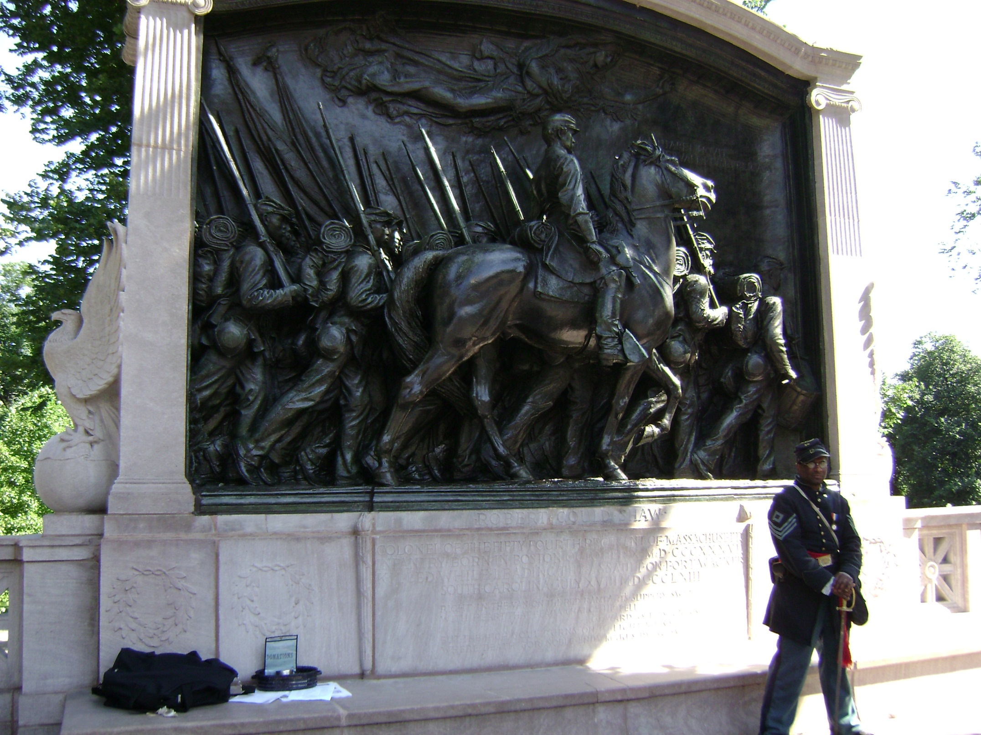

Slide 16
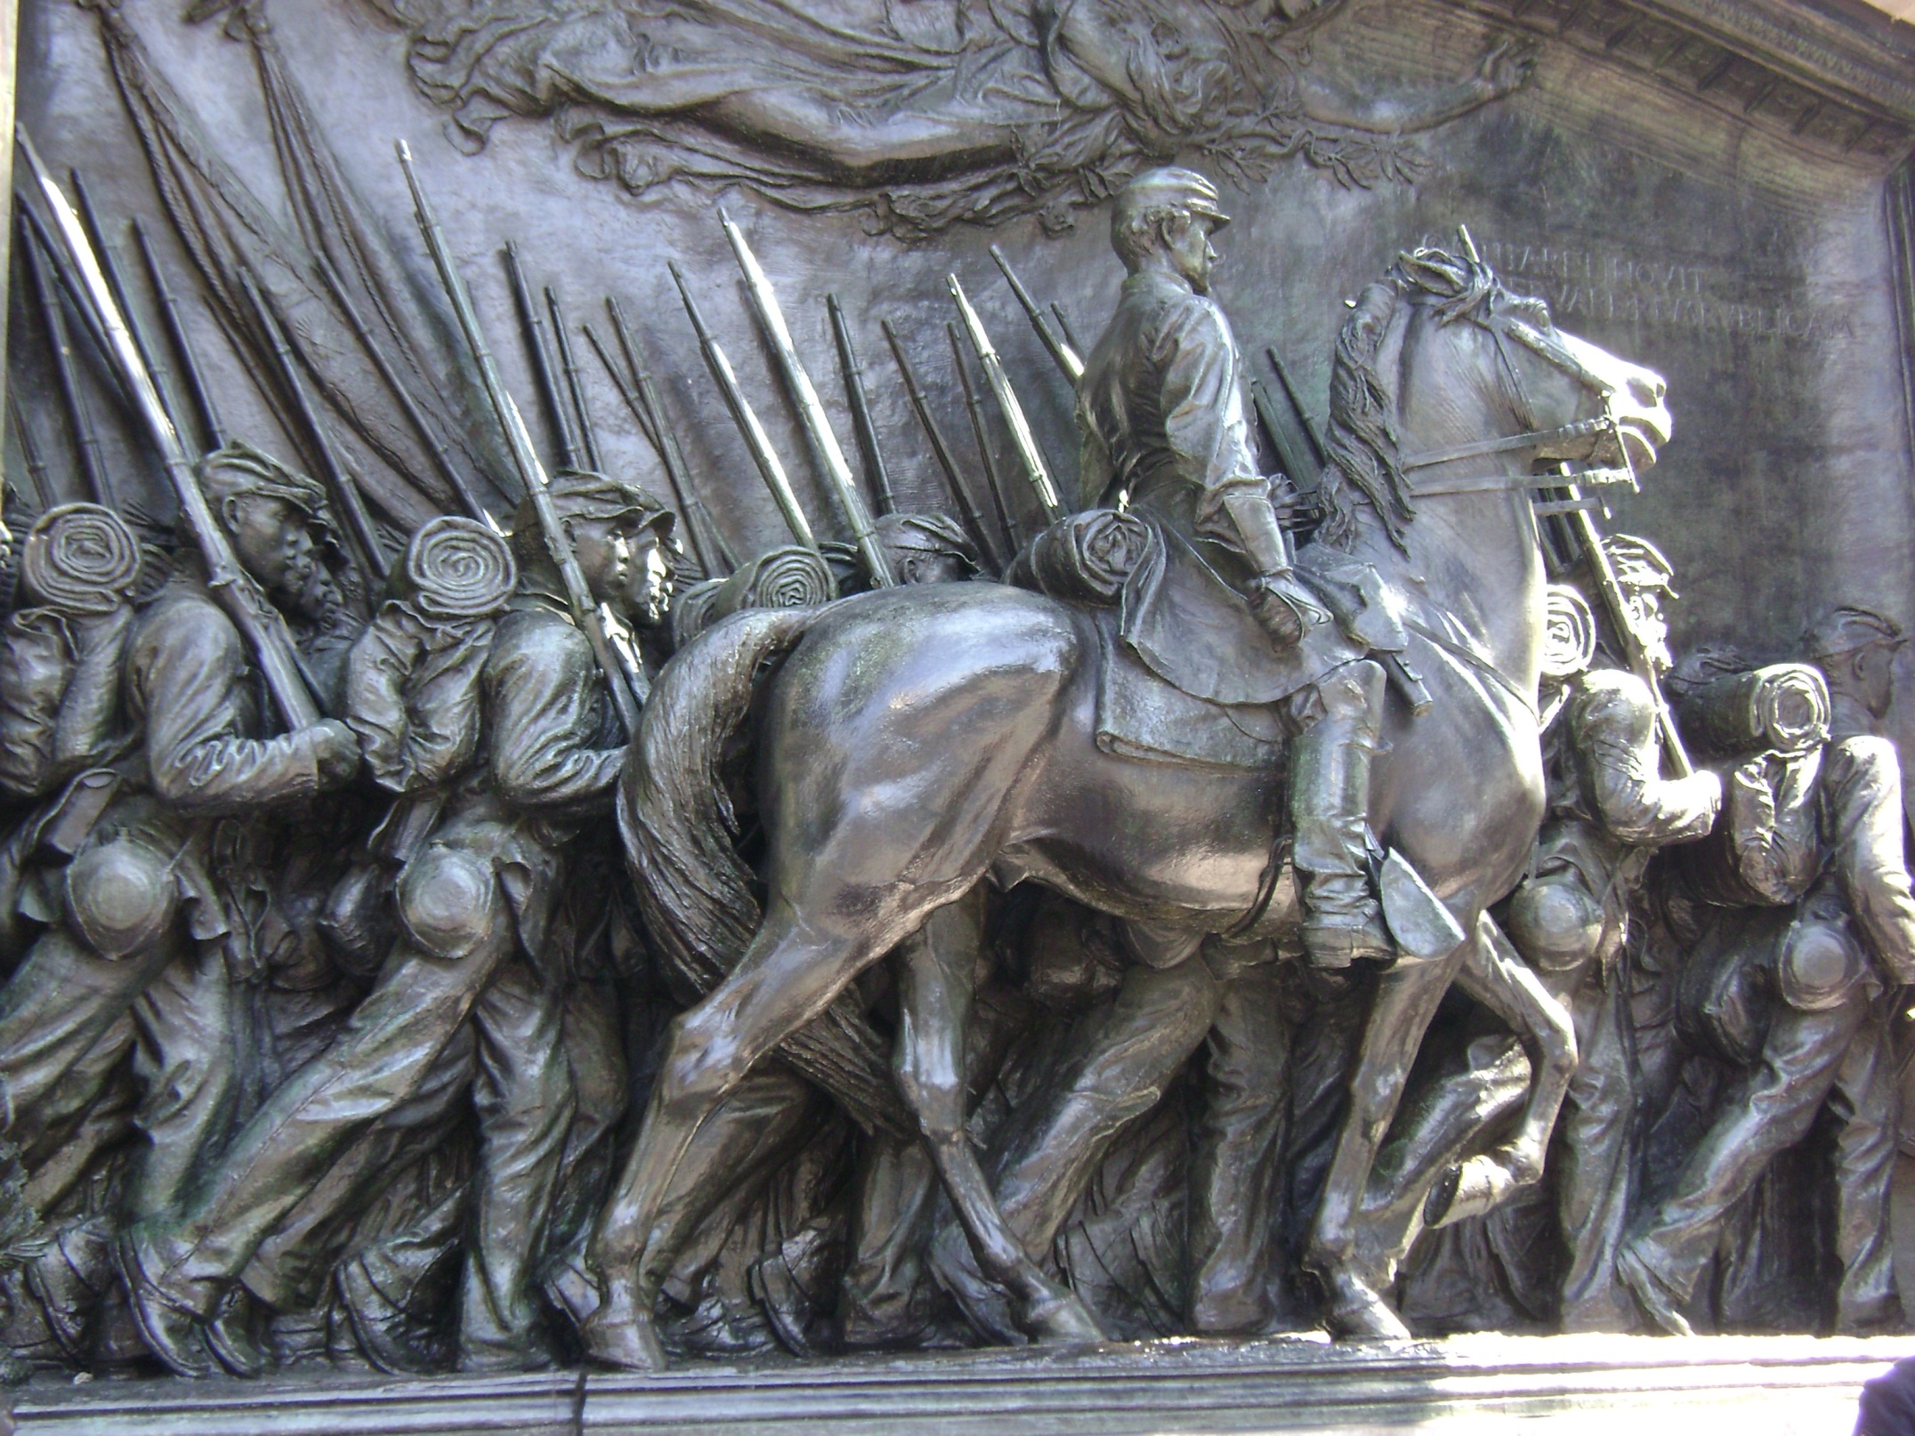

Slide 17
African American soldiers received less pay and faced greater danger.
If captured they could be killed or sold back into slavery.
About 180,000 African Americans served with the Union army.

Slide 18
Growing Opposition
Some people didn’t think the war was necessary.
They called themselves Peace Democrats.
Their enemies called them Copperheads, after the poisonous snake.
Many were midwesterners who sympathized with the South and opposed abolition.
Lincoln suspended habeas corpus, or protection against unlawful imprisonment, to jail the enemies of the Union.

Slide 19
Northern Draft
Critics erupted when Congress approved the draft, or forced military service.
For $300, men could buy their way out of service. For unskilled workers, this was a year’s wage.
Bloody rioting broke out in New York, killing 100 people.

Slide 20
Life for Soldiers
Civil War armies fought in ancient battlefield formations that produced massive casualties.
Endless rows of troops fired directly at one another.
Many men died to gain every inch of ground.
Doctors and nurses saved many lives.
They did not have medicines to stop infections.
The biggest killer in the war was disease, such as typhoid, pneumonia, and tuberculosis.
Military prisoners on both sides lived in misery.
They had little shelter, food, or clothing.
Starvation and disease killed thousands.

Slide 21
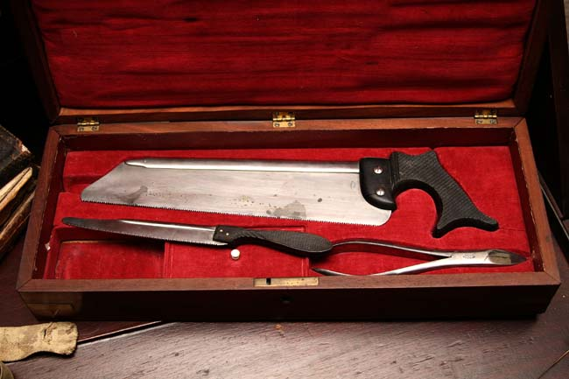

Slide 22
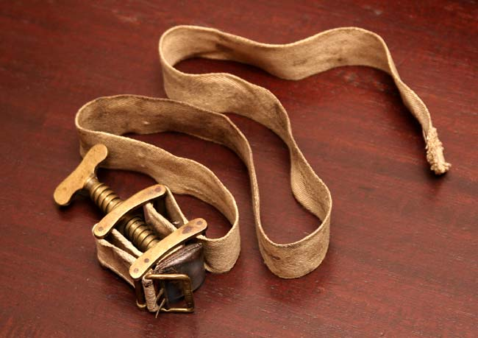

Slide 23
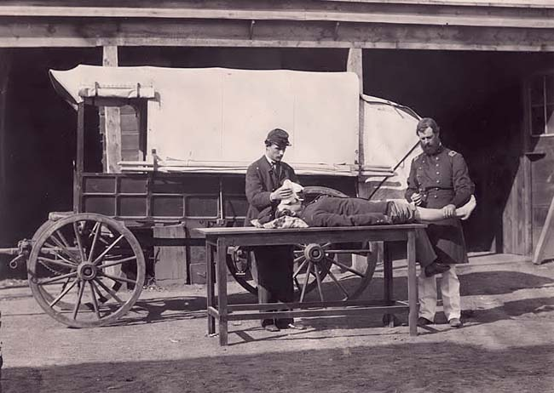

Slide 24
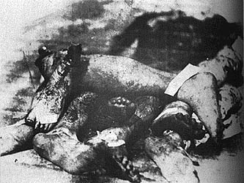

Slide 25
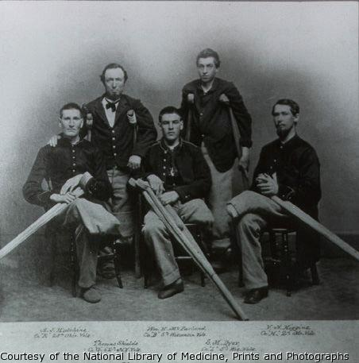

Slide 26
Life for Civilians
The war effort involved all levels of society.
Women and males too young or too old for military service worked in factories and farms.
Women were the backbone of civilian life on farms, performing daily chores usually done by men.
Union volunteer Clara Barton organized the collection of medicine and supplies for delivery to the battlefield.
In the South, Sally Louisa Tompkins established a small hospital that became a major army hospital.

